Slide 1
Solar Energy Forecasting Using Weather data and Machine Learning methods
Bradley Payne

Slide 2
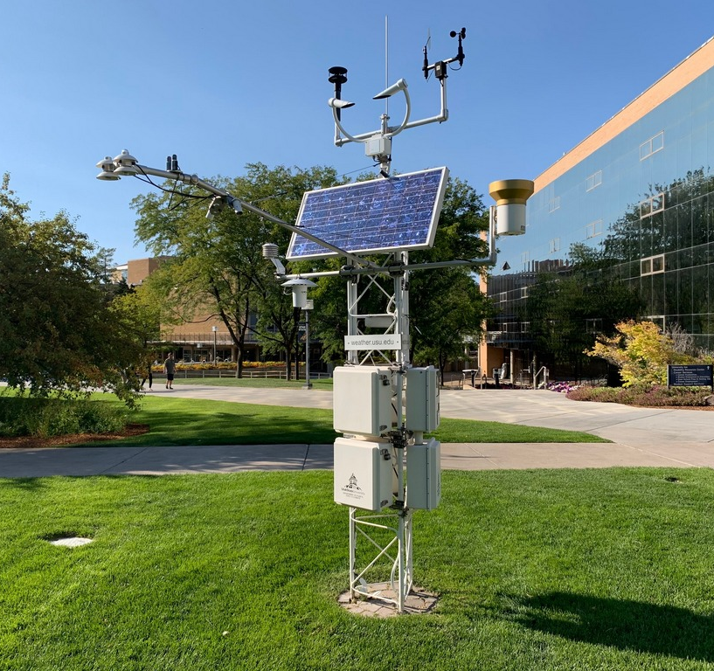
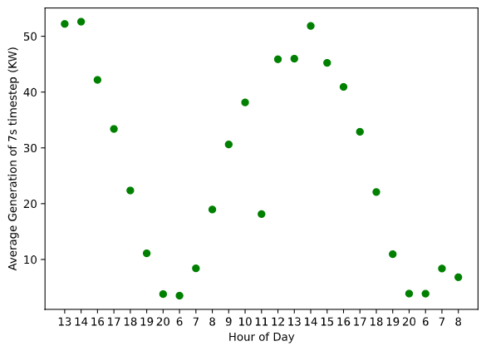
The Data
Weather Data from USU Climate center
Solar Generation from Aspire labs
USU Environmental Observatory

Slide 3
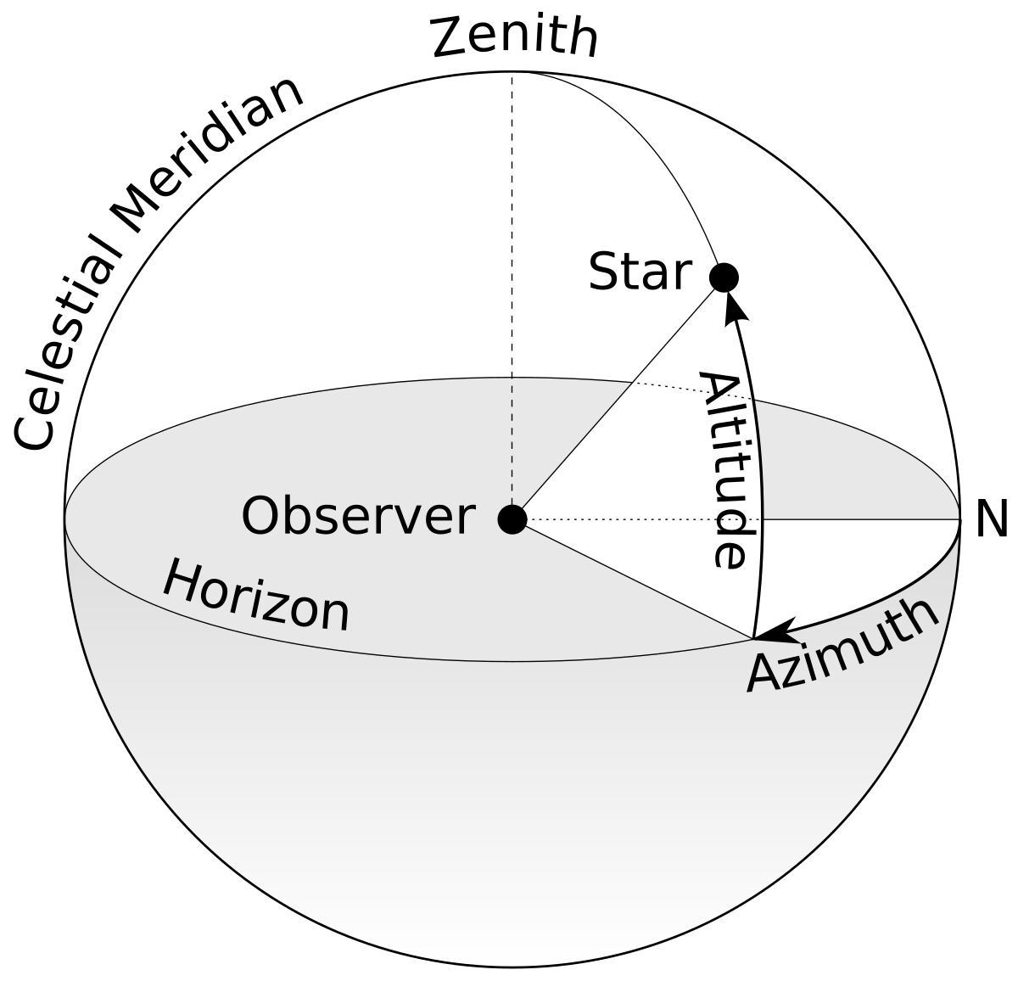
Data Curation
31% of the Solar Data was garbage collection or otherwise corrupted
Experimented with using the aggregate sum of hour as well as the average produced by each timestep in a certain hour
Supplemented weather data with Azimuth, Zenith, and Elevation angle for each hour (using Astral package)

Slide 4
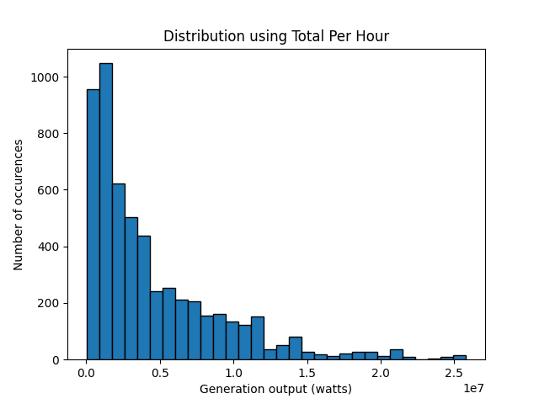
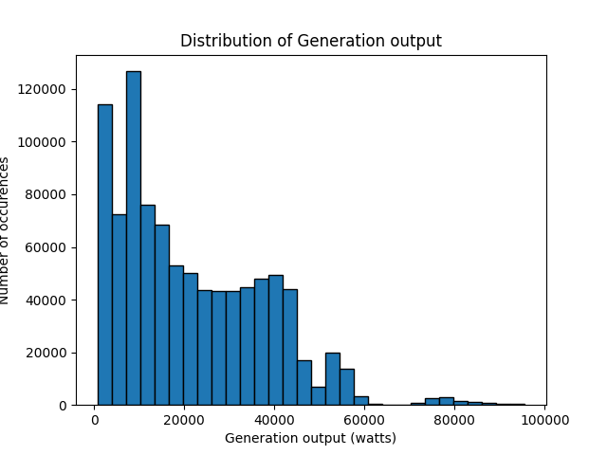
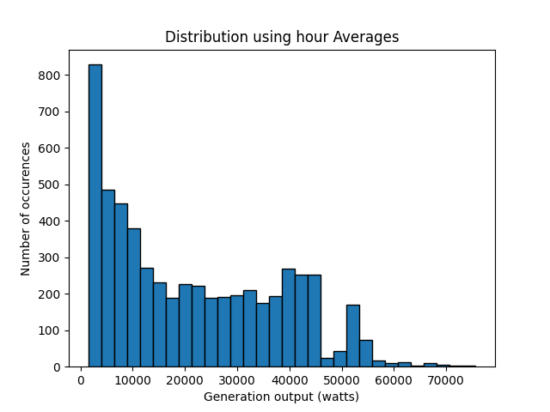
Solar Data

Slide 5
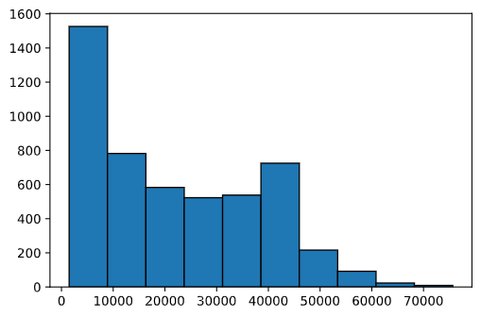
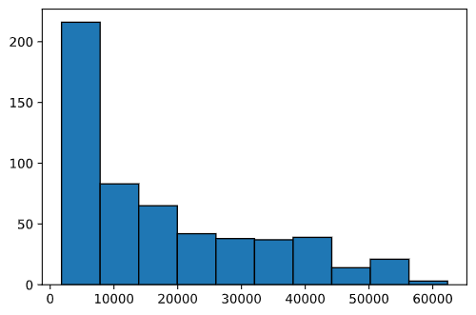
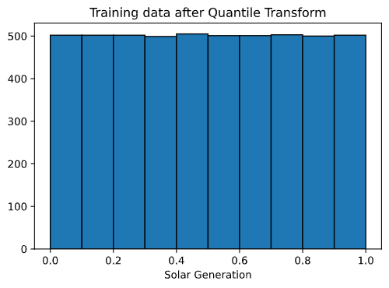
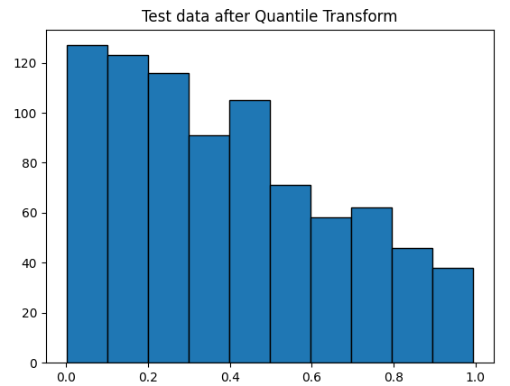
Split and transform
85 – 15 training, testing split
Transformed using QuantileTransformer in sklearn
Transformation helped models

Slide 6
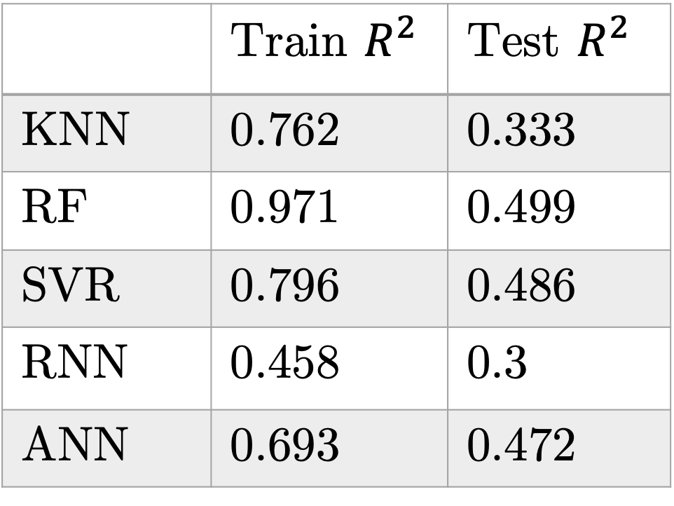
Results (on total solar)
 | Train $R^{2 }$ | Test $R^{2}$
KNN | 0.762 | 0.333
RF | 0.971 | 0.499
SVR | 0.796 | 0.486
RNN | 0.458 | 0.3
ANN | 0.693 | 0.472
K-Nearest Neighbors(KNN)
Random Forest (RF)
Support Vector Regression (SVR
Recurrent Neural Network (RNN)
{L10, L10, 10, 1}, Adam, lr 0.001, batch size 128, epochs 100, dropout 0.2
Artificial Neural Network (ANN)
{20, 10, 1} Adam, lr 0.001, batch size 50, epochs 100, dropout 0.2

Slide 7
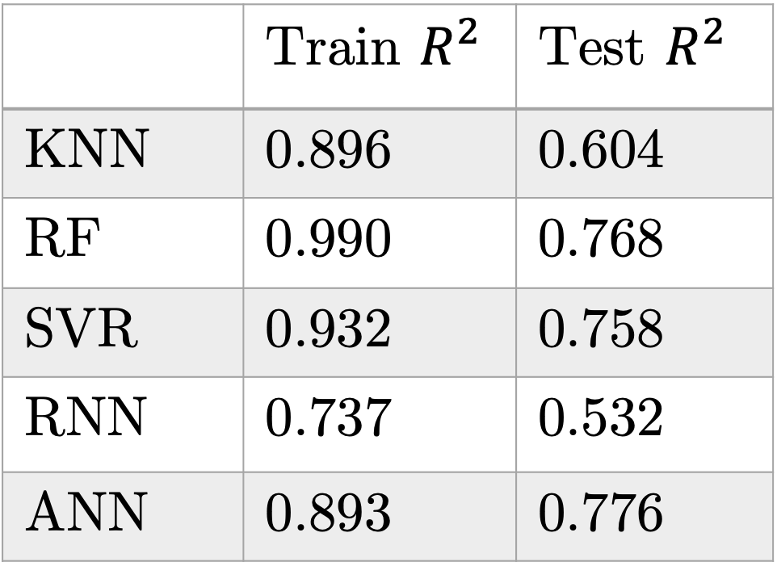
Results (on average solar)
 | Train $R^{2 }$ | Test $R^{2}$
KNN | 0.896 | 0.604
RF | 0.990 | 0.768
SVR | 0.932 | 0.758
RNN | 0.737 | 0.532
ANN | 0.893 | 0.776
K-Nearest Neighbors(KNN)
Random Forest (RF)
Support Vector Regression (SVR
Recurrent Neural Network (RNN)
{L10, L10, 10, 1}, Adam, lr 0.001, batch size 128, epochs 250, dropout 0.2
Artificial Neural Network (ANN)
{20, 10, 1} Adam, lr 0.001, batch size 50, epochs 100, dropout 0.2

Slide 8
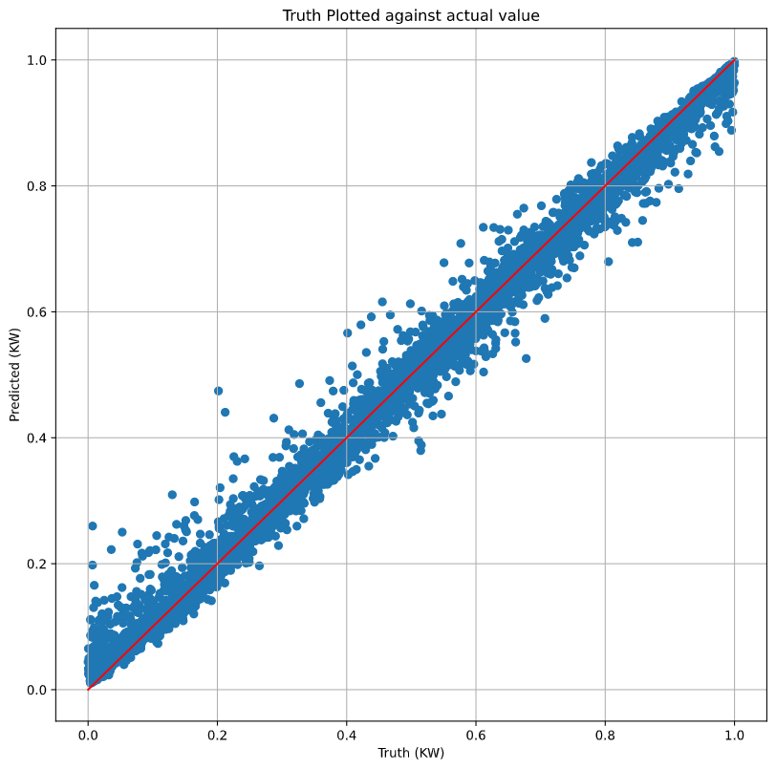
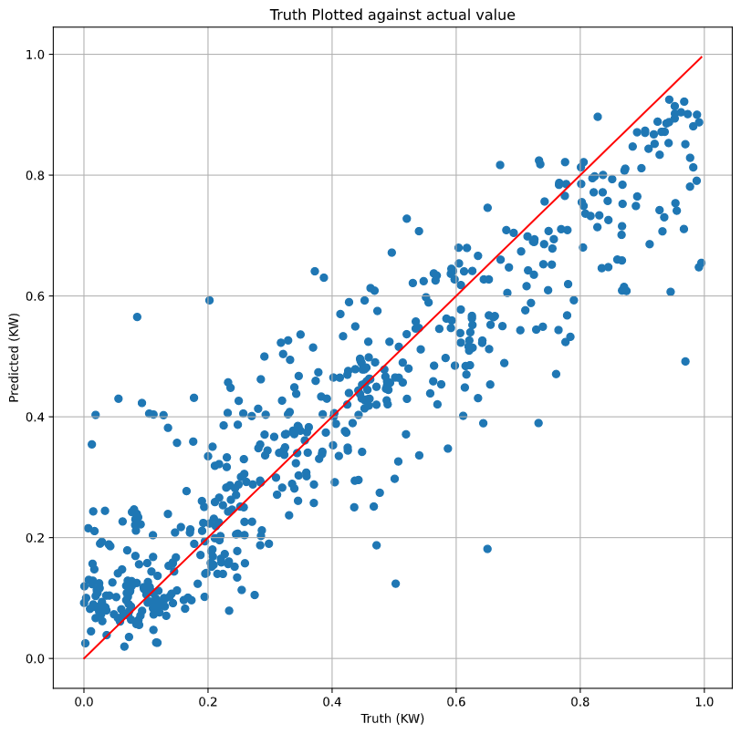
Results continued (RF)

Slide 9
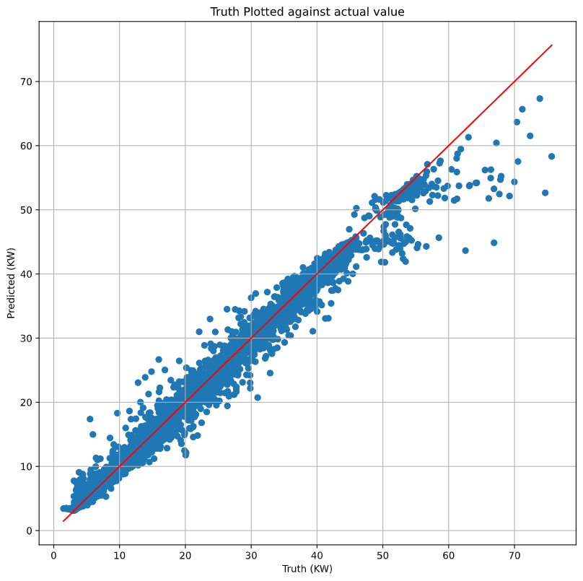
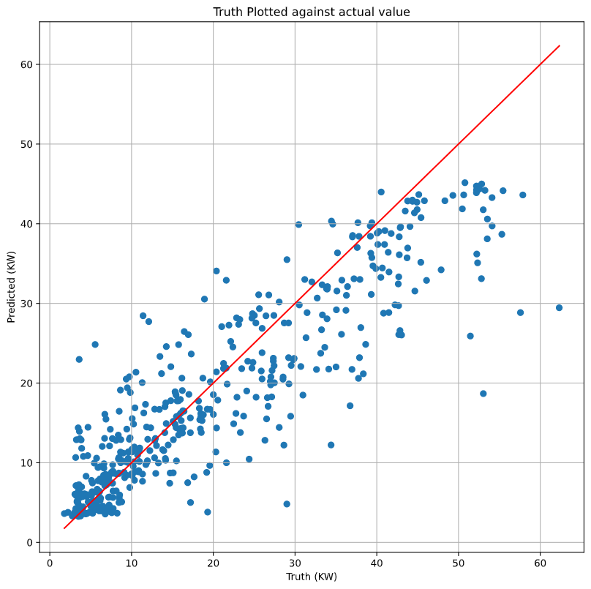


Results continued (RF)
$$R^{2}:0.990$$
$$R^{2}:0.768$$

Slide 10
Next Tasks
Based on Research Papers’ methods:
Split data into seasons and fit random forest
Previous average for hour of day
This problem, at the root, is a weather prediction problem. Something with that?
PCA (if time)
For the Class:
Poster
Paper

